Slide 1
Multinomial logit regression
A.Zorlu
GPIO, UvA

Slide 2
Outline
Dealing with missing values
Multinomial logit model
A brief introduction
When to apply
Constructing Y for a Mlogit model
Applications, interpretation of results
Last assignment

Slide 3
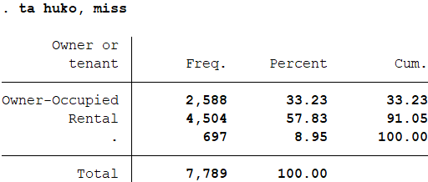
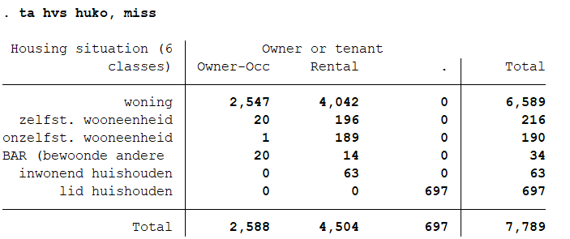
How to deal with missings?
If some values of Y are missing
What to do?
. Are missings to explain (through other variables)
. Are missings to add to an existing category?
-if not, ignore the missings in Y

Slide 4
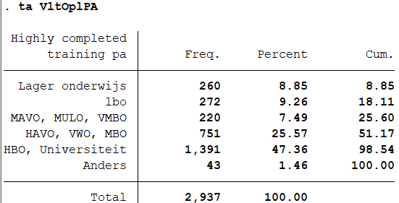
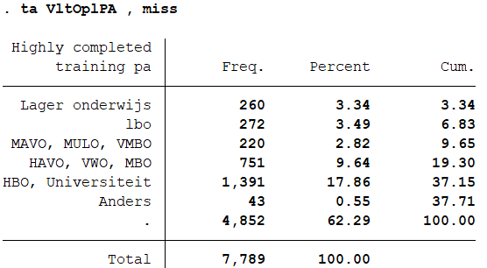
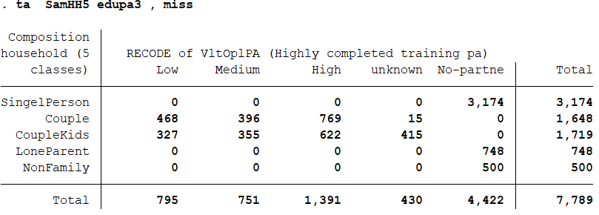
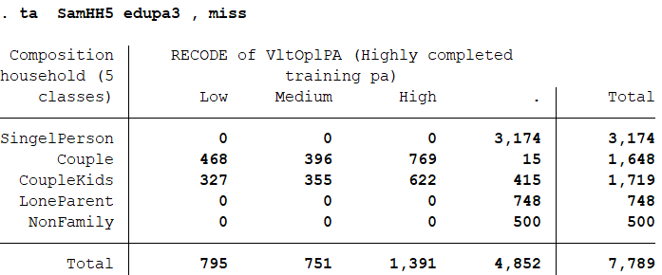
How to deal with missings?
2. If some values of a X are missing
What to do with a factor X variable?
. Are missings to explain (through other variables)
. Are missings to add to an existing category?
- if not, code the missings as a separate category

Slide 5
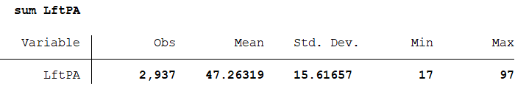
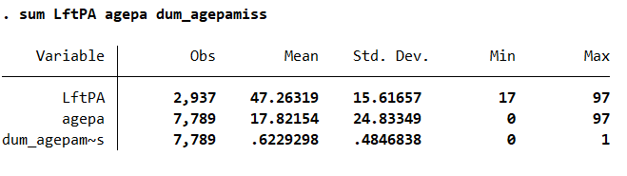
How to deal with missings?
2. If some values of a X are missing
What to do with a continues variable?
. recode missings as 0
. Create a dummy for missings: 1 if missings, 0 otherwise

Slide 6
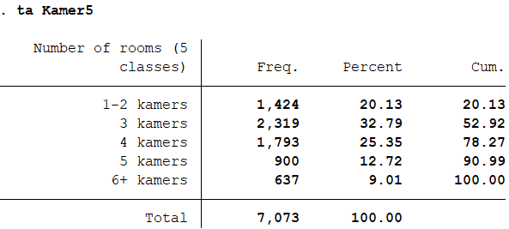
Multinomial logit (mlogit) regression: when needed?
Dependent variable: a nominal Y with more than 2 categories.
# Rooms: how to use?
Three major options:
Use the original variable if possible
Dichotomize the original variable: small vs large house
Recode the original variable into a new variable with fewer categories:
Small (1-2r),
Starter (3r)
Comfort (4)
Large (5 and more)
Implications of our choice?
Notes:
Ask a couple of students their preferences

Slide 7
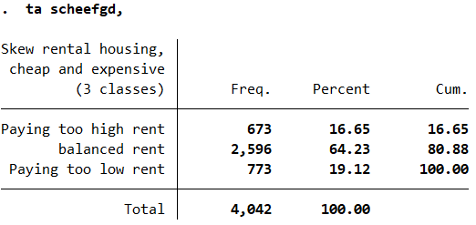
Multinomial logit model
Dependent variable (Y): a nominal (factor) variable with 3 or more categories
‘dure scheefheid’: relative high rent in private sector
‘geen scheefheid: balanced rent
‘goedkope scheefheid’: relative low rent in social sector
independent variables (x): ?
Notes:
Ask pairs to design a research question (give 3 minutes)

Slide 8
Multinomial logit (mlogit) regression
One category is chosen to be the base (reference) category for the other categories
If Non-Skewness is the base category, then two logit models must be estimated :
High Rent versus Non skewness
Low Rent versus Non skewness
Estimation: simultaneously
Presentation: as a single model

Slide 9
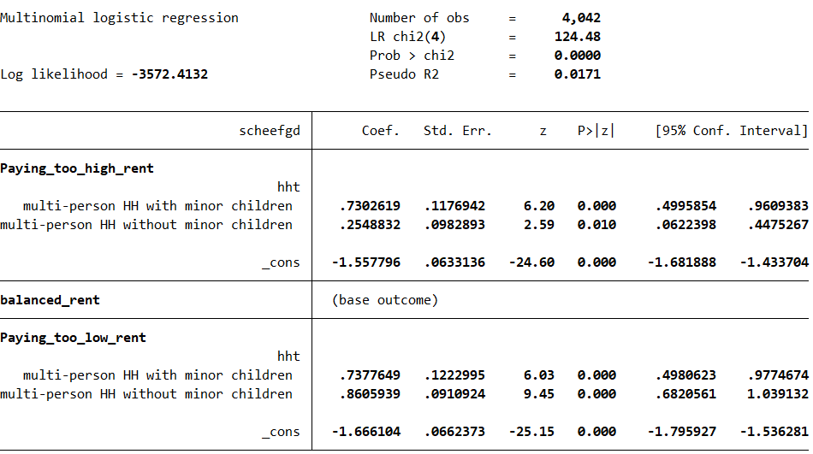
Multinomial logit model of rent-skewness
Categorical variable; Two references:
the reference of the response; indiff.
the reference of the variable; Dutch
Multi-person households are more likely either high rent payers or low rent payers than single person households, relative to the balanced rent

Slide 10
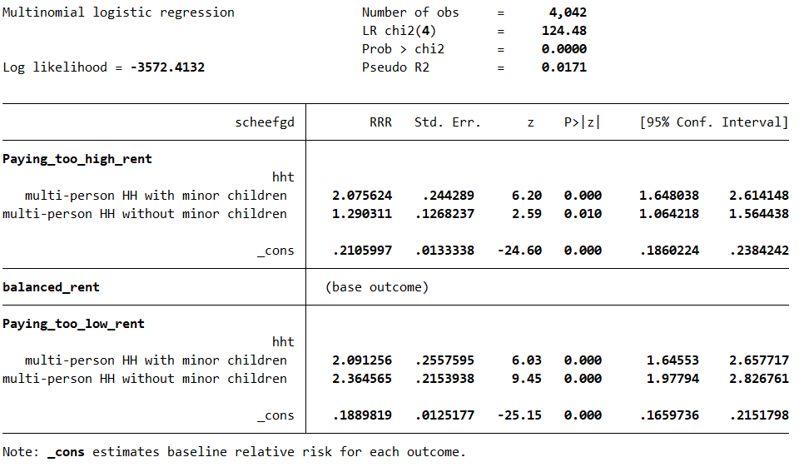
Multinomial logit model of rent-skewness
factor variable; Two references:
the reference of the response; balanced
the reference of the variable hht; single person hh
The risk of paying high rent, compared to balanced rent is 2,07 times greater for multi-person hh with child relative to single person hh.

Slide 11
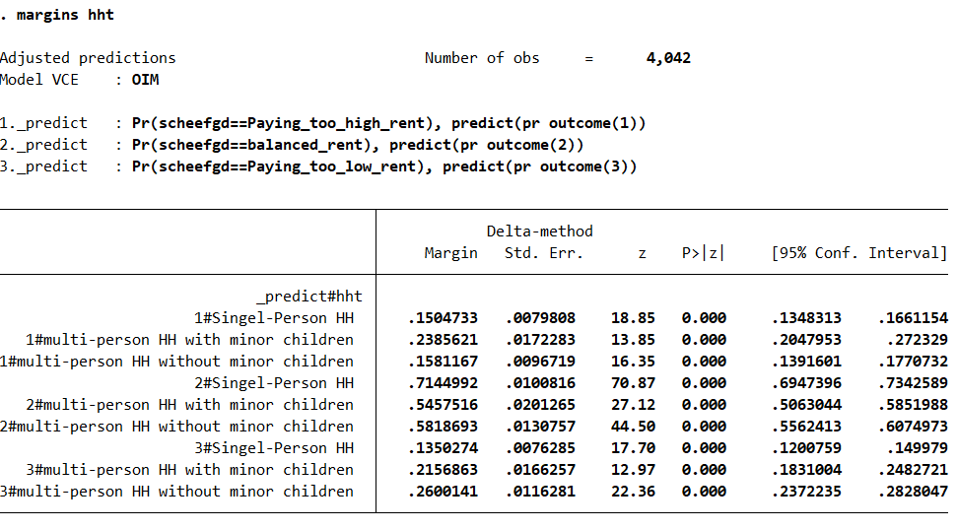
Alternative presentation: probabilities

Slide 12
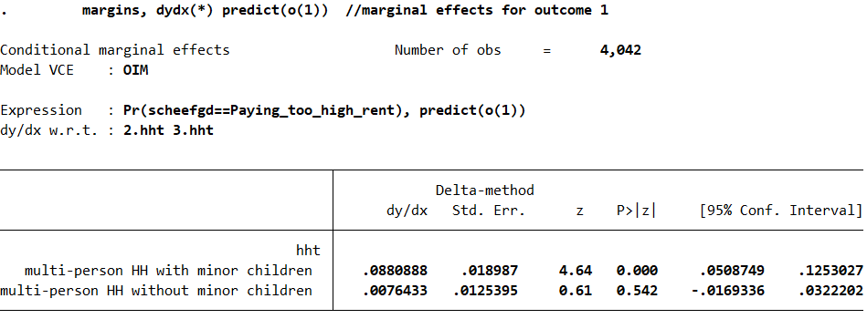
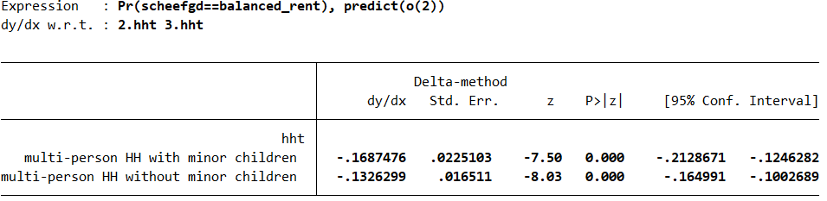
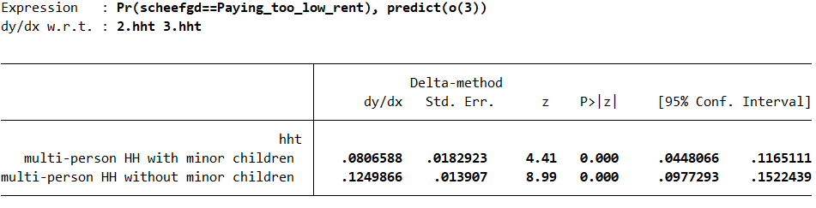
Alternative presentation of estimates: marginal effects

Slide 13
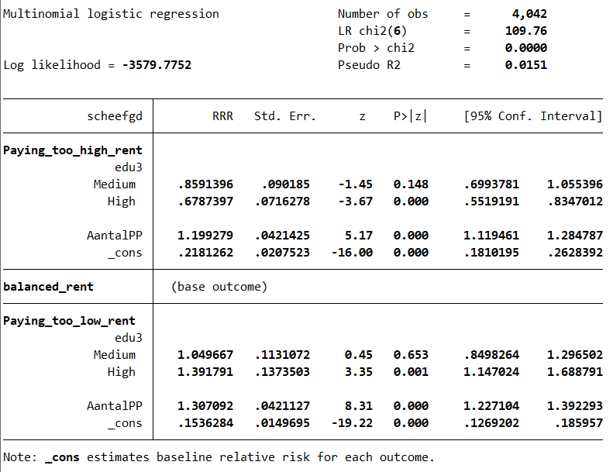
Another Example: multivariate multinomial logit model
Table 1. Multinomial logit estimation of neighbourhood satisfaction
Continues variable (AantalP), -one reference
The odds of paying high rent, compared to the balanced, increases by 1.19 times (rrr=1.19) with each additional person holding education constant.
Categorical variable (ethnicity); Two references:
The odds of paying low rent, compared to the balanced is 1.39 times greater for high educated relative to low educated holding persons in hh constant.

Slide 14
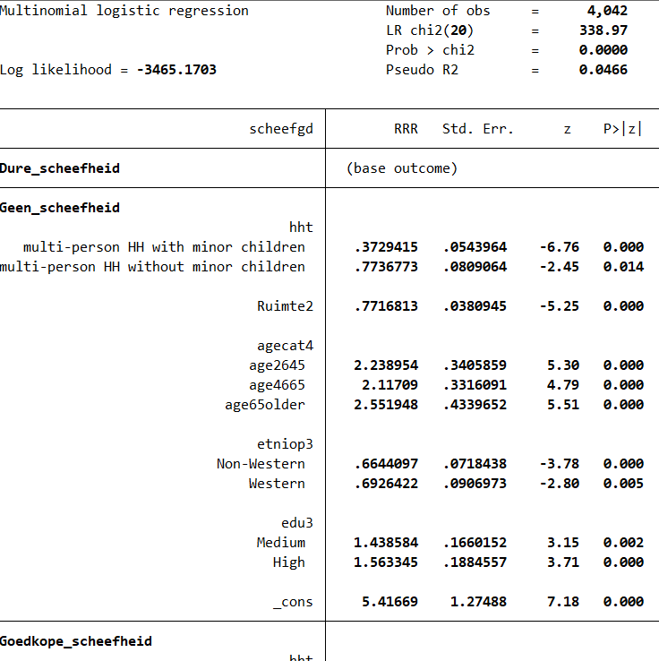
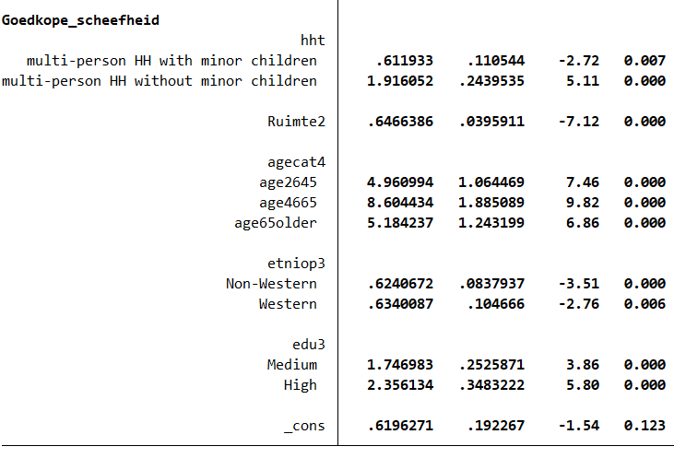
Multivariate multinomial logit regression; what and how to present not like this!

Slide 15
Multivariate multinomial logit regression: presentation RRRs
 |  | High rent |  | Low rent
 |  | RRR | p-val | RRR | p-val
Household | singe person hh (ref)
 | mphh with children | 2.681 | 0.000 | 1.641 | 0.001
 | mphh without children | 1.293 | 0.014 | 2.477 | 0.000
 | Room surplus | 0.000 | 0.838 | 0.000
Age | age1825 (ref)
 | age2645 | 0.447 | 0.000 | 2.216 | 0.000
 | age4665 | 0.472 | 0.000 | 4.064 | 0.000
 | age65older | 0.392 | 0.000 | 2.031 | 0.000
Ethnicity | Dutch (ref)
 | Non-Western | 1.505 | 0.000 | 0.939 | 0.559
 | Western | 1.444 | 0.005 | 0.915 | 0.503
Education | Low (ref)
 | Medium | 0.695 | 0.002 | 1.214 | 0.091
 | High | 0.640 | 0.000 | 1.507 | 0.000
 | _cons | 0.185 | 0.000 | 0.114 | 0.000
 | Pseudo R2 | 0.047
 | N | 4,042

Slide 16
Multivariate multinomial logit regression: marginal effects
 |  | High rent | Proper | Low rent
 |  | Marg.Eff | Marg.Eff | Marg.Eff
Household | singe person hh (ref)
 | mphh with children | 0.142 | -0.176 | 0.034
 | mphh without children | 0.007 | -0.140 | 0.132
 | Room surplus | 0.040 | -0.006 | -0.033
Age | age1825 (ref)
 | age2645 | -0.157 | 0.054 | 0.102
 | age4665 | -0.169 | -0.032 | 0.201
 | age65older | -0.171 | 0.078 | 0.093
Ethnicity | Dutch (ref)
 | Non-Western | 0.058 | -0.037 | -0.021
 | Western | 0.053 | -0.029 | -0.023
Education | Low (ref)
 | Medium | -0.057 | 0.020 | 0.037
 | High | -0.073 | 0.000 | 0.073
 | Pseudo R2 | 0.047
 | N | 4,042

Slide 17
How to present M Logit models
Examples:
https://onlinelibrary.wiley.com/doi/epdf/10.1002/psp.2268
https://doi.org/10.1177/0308518X18785905
http://journals.sagepub.com/doi/abs/10.1068/a45314

Slide 18
Concluding remarks
Regression analysis is a powerful research method
A simple regression is particularly for teaching (didactical) purposes; less informative.
FOCUS on multivariate regressions are always more preferred.
To isolate and measure effects of variables, while controlling for other variables
Quantitative research: Balance between generating information and keeping simple, while following norms and conventions

Slide 19
Assignment 3
Another (Amsterdam) data set: Staat van de Stad, collected by Amsterdam OIS
Y: the frequency of contacts with people in the neighbourhood
X ? More freedom to choose variables

